Slide 1
Time complexity
March 3, 2023
Aadil Anthrollil Abu

Slide 2
Introduction
Time complexity is a measure of how long an algorithm takes to run as the size of its input increases.
The time complexity of an algorithm can be expressed using the big O notation
Understanding time complexity is essential for developing efficient and scalable Java programs

Slide 3
Big O notation
The big O notation is a mathematical notation used to describe the upper bound of an algorithm's time complexity.
It represents the worst-case scenario for the algorithm's performance as the size of the input increases.
The notation is read as "big O of" and the algorithm's time complexity expression.
The most common time complexity classes in big O notation are O(1), O(n), O(log n), O(n^2), and O(2^n).

Slide 4
Example of time complexity in java
O(1): constant time complexity, where the algorithm's runtime remains the same regardless of the input size.
Example: accessing an element in an array by index, performing a single arithmetic operation.
O(n): linear time complexity, where the algorithm's runtime increases linearly with the input size.
Example: iterating through an array or a list, performing a linear search.

Slide 5
Example of time complexity in java
O(log n): logarithmic time complexity, where the algorithm's runtime increases logarithmically with the input size.
Example: performing a binary search on a sorted array.
O(n^2): quadratic time complexity, where the algorithm's runtime increases quadratically with the input size.
Example: nested loops iterating through an array or a matrix.

Slide 6
Example of time complexity in java
O(log n): logarithmic time complexity, where the algorithm's runtime increases logarithmically with the input size.
Example: performing a binary search on a sorted array.
O(n^2): quadratic time complexity, where the algorithm's runtime increases quadratically with the input size.
Example: nested loops iterating through an array or a matrix.

Slide 7
How to calculate time complexity in java
Identify the algorithm
Count the operations
Determine the input size
Express the time complexity

Slide 8
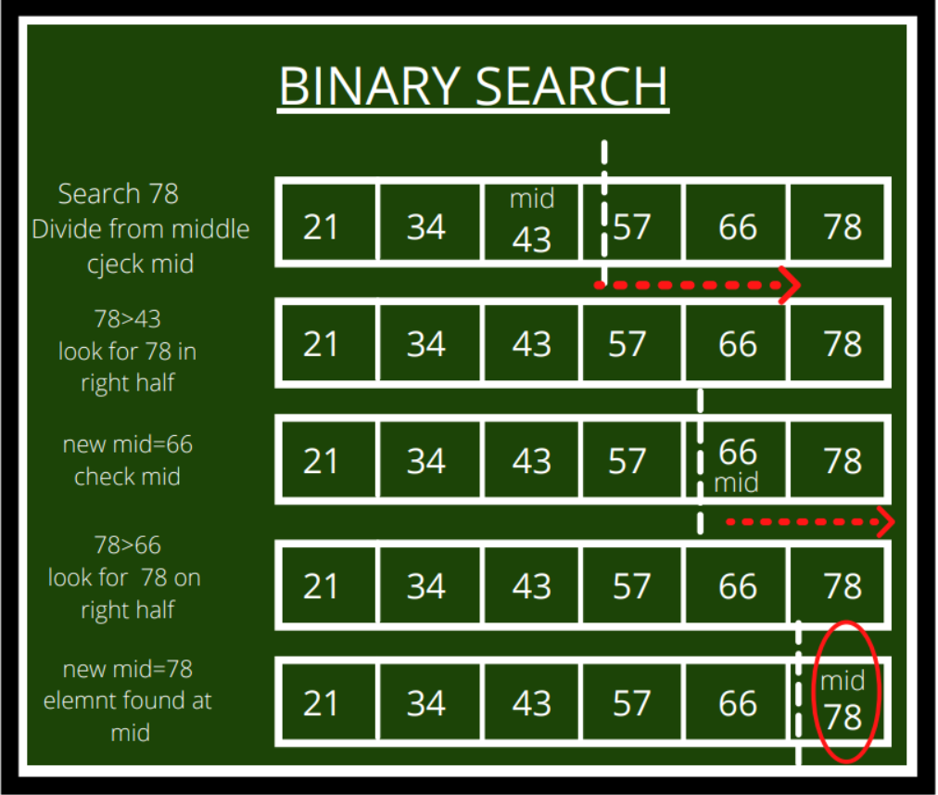
Calculate time complexity of Binary search
Comparing the target value to the middle element of the array
Dividing the search interval in half
Checking if the target value has been found

Slide 9
Best practices
Choose algorithms and data structures with lower time complexity to improve performance.
Be mindful of the time complexity of the algorithms and data structures used in your code.
Use benchmarking and profiling tools to measure the performance of your code and identify bottlenecks.
Optimize performance by reducing unnecessary operations, caching results, and parallelizing tasks.

Slide 10
Conclusion
Time complexity is an essential concept in computer science and programming, especially in Java.
By understanding time complexity, you can develop more efficient and scalable Java programs.
Remember to choose algorithms and data structures with lower time complexity, measure your code's performance, and optimize it for better performance.

